Slide 1
Louisiana Pathways Orientation/Updates
Presented by
Jenny Cowan
Program Coordinator

Slide 2
Louisiana Pathways
Louisiana Pathways is a statewide Early Learning Center Career Development System whose goal is to improve quality of child care in Louisiana.
It is a designed to help child care employees receive the recognition they deserve.
Participation is voluntary and there are no fees for enrolling;
Individuals MUST be enrolled :
to be eligible for the School Readiness Tax Credit for Directors and Staff
to be eligible for scholarships

Slide 3
Pathways promotes
Creating a quality workforce for early childhood programs by encouraging and supporting early childhood as a career
Increasing the quality of programs for young children by raising the level of education for all child care staff so children in Louisiana will have quality caregivers
Reducing turnover in the field

Slide 4
Pathways….
…is not a training agency. We do not provide workshops, CDA training or the NAC (National Administrator Credential) training.
…does not award the CDA or the NAC credential.

Slide 5
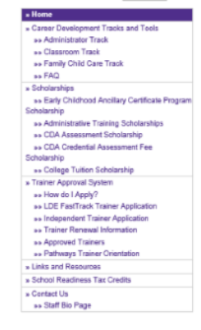
Career Development
Scholarships
Trainer Approval
Tax Credit Eligibility

Slide 6
Career Development
Maintains file folders and database which includes:
Demographics
Employment information (past & current)
Education
Training certificates, diplomas, degrees, transcripts, credentials (CDA, NAC)
Placement on career ladder
Membership to professional organization and service to the profession

Slide 7
Enrollment
Members should send original copies of enrollment form and employment verification forms. Can be scanned and emailed but prefer mail.
Employment verification form should be signed by someone, other than the member, who has access to employment records.
Members should send in copies of training records (workshop certificates, transcripts, credentials)

Slide 8
Enrollment
Link to Enrollment Form: https://www.nsula.edu/documentprovider/docs/941/Enrollment-Form11.4.20.pdf
Link to Employment Verification: https://www.nsula.edu/documentprovider/docs/941/08Verification-FormEmployment-revised.pdf

Slide 9
Enrollment Form:

Slide 10
Employment Verification:

Slide 11
After Enrollment
All correspondence, certificates & requests for additional information are sent to the member’s home address, not the center.
While directors may submit necessary information, it is ultimately the member’s responsibility to make sure their information is submitted for leveling.

Slide 12
Career Development
Career Ladders
Members are placed on career ladders based on information submitted:
Classroom Track
Administrator Track (Directors/Assistant Directors)
Family Child Care

Slide 13
Career Development
Current Career Ladders—General Guidelines
To be placed at a certain level, a member must meet or exceed the requirements in all columns. Members are placed at the highest level where all requirements are met.
Level is based on the information that is submitted to Pathways. Information received must be verifiable.

Slide 14
Career Ladders:
Classroom Track
https://www.nsula.edu/documentprovider/docs/942/Teacher-Track-2019.3.28.pdf
Administrator Track (Directors/Assistant Directors) https://www.nsula.edu/documentprovider/docs/942/Admin-ladder-2018-final3.pdf
Family Child Care
https://www.nsula.edu/documentprovider/docs/942/5FCC-Ladder-revised-final2.pdf

Slide 15
School Readiness Tax Credits for Directors & Staff
Pathways:
Places members on the career ladder based on the documentation received.
Members who are leveled at Early Learning Center Teacher 1, 2, 3, 4,and Master Teacher, or Director 1, 2, 3, and 4 are on tax credit eligible levels.

Slide 16
School Readiness Tax Credits for Directors & Staff
Pathways:
Mails SRTC forms to members who have achieved and maintained a tax credit eligible level on January 31st of the following year.
Advises LDOE & the Department of Revenue of all members who are on a tax credit eligible level.

Slide 17
Notes about SRTC
It is ultimately the member’s responsibility to make sure their information is submitted
Members should contact Pathways to update contact information and ensure that their level is current.
In order to maintain levels--CDA credentials, professional organization membership, and service to the profession must be current. Expired documents could result in moving to a lower level.

Slide 18
Notes about SRTC
In order to receive your tax form in early February, deadline for submitting information is December 31st of the previous year. Mail will be processed for the year that it is postmarked.
If information is received after December 31st, the member may request evaluation, but tax forms probably won’t be sent on January 31st.

Slide 19
Notes about SRTC
In addition to being on an eligible level, the member must also work for at least 6 months of the year at a star rated center to claim the tax credit.
Center must have at least a zero star rating on July 1st of the tax year
Louisiana Pathways does not give out any money. Members use the form provided to file with their Louisiana State Income Taxes.

Slide 20
More Information on Director/Staff Credit
Including all centers (even Unsatisfactory) and removing the professional activity requirement for teachers will ensure that all teachers with an ancillary certificate who work full time in a Type III center can receive the credit, making it easier to hire and retain qualified teachers.

Slide 21
Cover letter:

Slide 22
Instructions:

Slide 23
Sample tax
credit form:

Slide 24
How to find your center’s star rating for tax credits:
https://www.louisianabelieves.com/resources/library/child-care-provider-resources

Slide 25
Director’s Reports:
Email invitations were sent out to directors on file with licensing.
Please respond to invitation and request your Director’s Report if you haven’t already (include center’s name, license number, and your contact information).

Slide 26
Scholarships
College Tuition
CDA Assessment Fee
Administrative Training
NAFCC Accreditation
BESE approved Ancillary Certificate Programs CDA training

Slide 27
To be eligible for scholarships:
Must be enrolled and active in the Louisiana Pathways Career Development System.
Must have current verified employment at a Type III Early Learning Center as the director, assistant director, lead teacher, or assistant teacher or be a CCAP registered Family Child Care Home provider

Slide 28
College Tuition
For any Louisiana based accredited technical school, community college, or university that offers early childhood courses
Applicant must enroll in the school of their choice & complete all entrance requirements
For on-line or face-to-face classes
For one class or a full load (must maintain 2.0 GPA & continue your employment)
Must re-apply each semester/quarter

Slide 29
College Tuition
For coursework in Associate or Bachelor programs which focus on early childhood education.
For individual courses needed to meet Louisiana Pathways levels requirements

Slide 30
College Tuition
Application for financial aid is mandatory for all undergraduate students.
Complete your FAFSA application at www.fafsa.ed.gov
If you are eligible for a Pell Grant, it could pay for tuition, fees, plus additional funds for books etc, and would make a Pathways scholarship unnecessary.

Slide 31
College Tuition
You must submit your confirmation page which shows your financial aid status
You can receive a scholarship if you are not eligible for a Pell Grant or if you qualify for a partial Pell Grant.
If it states that you may be eligible for a Pell Grant, contact the financial aid office at your school to determine whether you will be offered a Pell Grant.

Slide 32
College Tuition
Scholarships to colleges and universities only cover tuition.
Textbooks and required fees are not covered.
Please refer to the College Tuition Guidelines on our webpage for more details.

Slide 33
College Tuition
An award letter will be mailed to your home address which includes an award agreement that you will need to complete and return in order to complete the process.
An award notice will also be sent to your school on your behalf.
If your scholarship application is received incomplete, a checklist requesting additional information will be mailed to you. Contact the scholarship department about the status of your application.

Slide 34
College Tuition Application Deadlines:
Summer Semester-April 16
Fall Semester – July 17
Spring Semester – Nov 27
For Louisiana Tech University:
Summer Quarter—May 2
Fall Quarter – Aug 8
Winter Quarter – Oct 30
Spring Quarter – Feb 6
*These dates do not change. Please make your calendars now for reminders. Late applications will not be processed.

Slide 35
CDA Assessment Fee Scholarship
Now pays the entire $425 CDA Assessment fee
Paid directly to the CDA Council
Applicant is responsible for purchasing the CDA Competency Standards book (approx. $25).

Slide 36
CDA Assessment Fee Scholarship
Submit the Scholarship Application
Return the CDA credential Application Check List (completed & signed by your director, instructor, or CDA mentor)
Return your transcript or letter from a training institute verifying the completion of 120 clock hours of training (at least 10 hours in each of the 8 CDA subject areas)
Training must come from BESE approved training provider (unless you can document having already earned at least 37 hours of CDA training prior to 7/1/18)

Slide 37
CDA Assessment Fee Scholarship
If awarded a scholarship, you will receive an award letter along with instructions on how to apply for your official CDA as a scholarship recipient.
Award letter also include an Award Agreement that you will have to fill out and return to Pathways (will need your CDA Candidate ID number to complete…. Begins with the number 2)

Slide 38
CDA Assessment Fee Scholarship
Wait for the CDA Council to review your application and send you the Ready to Schedule Notice.
Once you receive it by email, you may proceed to schedule your CDA Exam with Pearson Vue and your Verification Visit with your Professional Development (PD) Specialist.
Continue to check “YourCDA” for status updates.
Send Louisiana Pathways a copy of your CDA Credential once it has been awarded.

Slide 39
Administrative Training
Provides financial assistance for directors, assistant directors and aspiring directors to pursue specialized administrative training
Most administrative scholarships are for the National Administrator Credential (NAC) offered by National Early Childhood Program Accreditation (NECPA)
Others will be considered if cost is more than $200

Slide 40
Administrative Training
Pathways processes the scholarship only. Contact the sponsoring agency to register for the course.
Submit proof of enrollment along with your scholarship application.
Also include a letter of intent explaining how the course will help you reach your goals for providing quality care for young children.
Aspiring directors will also need to send a letter of recommendation.

Slide 41
Administrative Training
The scholarship payment will go directly to the sponsoring agency
We will notify you as soon as possible after a review of your application

Slide 42
NAFCC Accreditation
For Family Child Care providers wishing to become an accredited home.
Application is on the website

Slide 43
Trainer Approval
All training used for annual training through licensing must be provided by a Pathways approved trainer.
Qualifications and Application Process has been revised. New system went into effect September 1, 2015.

Slide 44
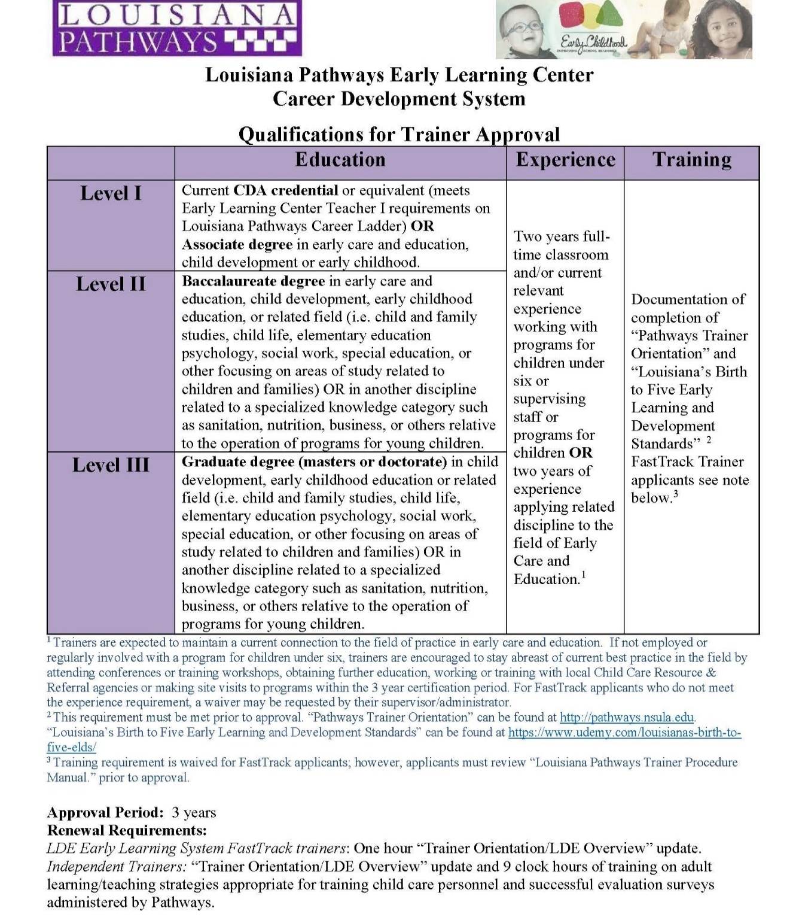

Slide 45
In order to become a part of the Trainer Registry, an individual may register through :
LDE System FastTrack application process (if eligible)
Independent trainer application process

Slide 46
The following individuals are eligible for the FastTrack application process:
School Board Staff or Teachers
LA Department of Education Staff
Early Steps Staff/Contractor
Community Network Lead Agency Staff
Trainer/TA for Resource and Referral Agency
Head Start Staff
Mental Health Consultant with LDE Contractor

Slide 47
Director or Assistant Director of a licensed Type III Early Learning Center at Pathways Director I level or higher (subject to verification)
Lead Teacher at a licensed Type III Early Learning Center at Pathways Teacher I or higher (subject to verification & recommendation of Director).
All others should complete the Independent Trainer application process.

Slide 48
LDE System FastTrack Trainer Initial Application Process
The following information should be submitted to Louisiana Pathways:
FastTrack Trainer Approval Application. Application includes agency verification that trainer meets qualifications and has reviewed “Louisiana Pathways Trainer Procedure Manual.”
Trainer Agreement and Release Form
CLASS reliability certificates or CLASS Trainer certificates, if applicable.
TS Gold Trainer or Inter-rater reliability certificates, if applicable.

Slide 49
If approved, the trainer will receive a certificate from the Louisiana Pathways certifying them as Trainer I, II or III based on their documented education and experience as verified by their administrator/supervisor. Subject areas taught are determined by supervising agency.
Initial approval and each renewal will be effective for a period of 3 years.

Slide 50
FastTrack Trainer Renewal Requirements
Completion of “Trainer Orientation/LDE Overview Update” offered at various conferences and available at no cost on the Louisiana Pathways website-- http://pathways.nsula.edu/trainer-renewal-information/
Continued employment in a FastTrack eligible category as verified by Supervisor/Administrator

Slide 51
FastTrack Trainer Renewal Process
In order to renew trainer certification, an individual should submit the following information to Louisiana Pathways as least one month prior to their expiration date:
Trainer Renewal Application
Trainer Agreement and Release form.
Documentation of “Trainer Orientation/LDE Overview Update” if not taken on website
Current certifications (CLASS reliability, CLASS trainer, TS Gold Trainer, TS Gold Inter-rater reliability)

Slide 52
Independent Trainer Initial Application Process
The following information should be submitted to Louisiana Pathways:
Trainer Approval Application
Trainer Agreement and Release Form
Current Resume’
Documentation of Educational Background (transcripts, copies of credentials, licenses)
Two Trainer Skills Surveys completed by people who have observed them training.
And…..

Slide 53
Documentation of completion of “Pathways Trainer Orientation” (http://pathways.nsula.edu) and “Foundations-Including CONNECT-Standards, Instruction and Assessment” (www.louisianabeleives.com/resources/library/early-childhood).
Current CLASS reliability, CLASS trainer, TS Gold Trainer, TS Gold Inter-rater reliability certificates, if applicable.

Slide 54
If approved, the trainer will receive a certificate from the Louisiana Pathways recognizing the trainer level and approved areas for training (CDA Subject areas). Individuals will be certified as Trainer I, II or III based on their documented education and experience.
Initial approval and each renewal will be effective for a period of 3 years.

Slide 55
Independent Trainer Renewal Requirements
During each 3-year renewal period an individual should:
Complete “Trainer Orientation/LDE Overview Update” offered at various conferences and available at no cost on the Louisiana Pathways website-- http://pathways.nsula.edu/trainer-renewal-information/
Complete 9 clock hours of training in adult learning/presentation skills appropriate for training child care personnel (Train the Trainer)

Slide 56
Independent Trainer Renewal Process
In order to renew trainer certification, an individual should submit the following information to Louisiana Pathways as least one month prior to their expiration date:
Trainer Renewal Application
Trainer Agreement and Release form.
Documentation of “Trainer Orientation/LDE Overview Update”
Documentation of 9 clock hours of training in adult learning/presentation skills appropriate for training child care personnel (Train the Trainer)

Slide 57
Train the Trainer Topics must be relevant
to adult learning/presentation skills (i.e.—things that will improve training skills such as how to use audio visual aids, training activities, icebreakers, facilitation skills, how to plan training, implementing new techniques…)
Train the trainer sessions used to teach director skills or how to teach children would not count.
Training to teach content of a particular curriculum or program would not receive full credit—only those hours relevant to adult learning /presentation skills.

Slide 58
Sources of Adult Education training
Conferences
ASTD (American Society for Training & Development) Meetings
College Classes
Toastmasters
Workshops & seminars
Article Summaries—1 clock hr (maximum of 3 per renewal period)

Slide 59
Websites for Train the Trainer hours:
http://www.nsu-cfn.org/online-workshops/ There are 15 clock hours available on this link.
http://www.carecourses.com/Ecommerce/CourseDetail.aspx?ItemID=95 Facilitating Staff Skill Development is 14 hours.
http://www.cceionline.com/courseCatalog.cfm?&viewCourseDesc=0&language=1&subCat=7 The course entitled “Adult Learning: Theories & Strategies” counts for 1 clock hour
http://www.childcareexchange.com “Training Early Childhood Staff” 10 clock hour (1 CEU)
http://www.ed2go.com/online-courses/teaching-adult-learners “Teaching Adult Learners” 24 clock hours

Slide 60
Contact Information
Phone number: 1-800-245-8925
Website: http://pathways.nsula.edu
Email: Jenny Cowan cowanj@nsula.edu
Facebook: facebook.com/lapathways

